Slide 1
Introduction to Text-to-Image Models
Harvey Mannering

Slide 2
Overview
Technical Details
Applications
Ethics Considerations

Slide 3
How Do Text-to-Image Models Work?

Slide 4
Text-to-Image Model
Text-to-image models typically work in two stages:

Slide 5
Text-to-Image Model
Text-to-image models typically work in two stages:
Encoding Text using CLIP

Slide 6
Text-to-Image Model
Text-to-image models typically work in two stages:
Encoding Text using CLIP
Generate an image using that CLIP encoding

Slide 7
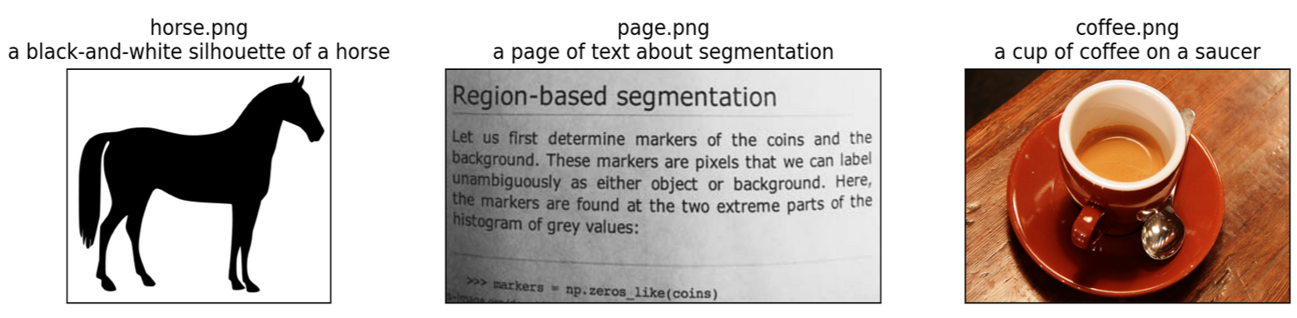
CLIP (Contrastive Language-Image Pre-Training)
a black-and-white silhouette of a horse
a page of text about segmentation
a cup of coffee on a saucer
[1] Radford, Alec, et al. "Learning transferable visual models from natural language supervision." International conference on machine learning. PMLR, 2021.

Slide 8
CLIP (Contrastive Language-Image Pre-Training)
a black-and-white silhouette of a horse
a page of text about segmentation
a cup of coffee on a saucer
[1] Radford, Alec, et al. "Learning transferable visual models from natural language supervision." International conference on machine learning. PMLR, 2021.

Slide 9
CLIP (Contrastive Language-Image Pre-Training)
a black-and-white silhouette of a horse
a page of text about segmentation
a cup of coffee on a saucer
Text Encoder
Image Encoder
[1] Radford, Alec, et al. "Learning transferable visual models from natural language supervision." International conference on machine learning. PMLR, 2021.

Slide 10
CLIP (Contrastive Language-Image Pre-Training)
a black-and-white silhouette of a horse
a page of text about segmentation
a cup of coffee on a saucer
Text Encoder
Image Encoder
[1] Radford, Alec, et al. "Learning transferable visual models from natural language supervision." International conference on machine learning. PMLR, 2021.

Slide 11
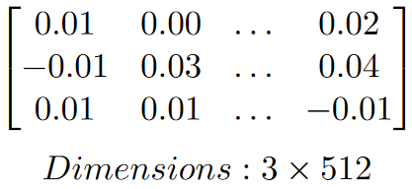
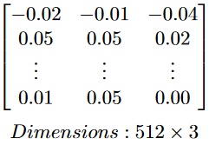
CLIP (Contrastive Language-Image Pre-Training)
a black-and-white silhouette of a horse
a page of text about segmentation
a cup of coffee on a saucer
Text Encoder
Image Encoder
[1] Radford, Alec, et al. "Learning transferable visual models from natural language supervision." International conference on machine learning. PMLR, 2021.

Slide 12
CLIP (Contrastive Language-Image Pre-Training)
a black-and-white silhouette of a horse
a page of text about segmentation
a cup of coffee on a saucer
Text Encoder
×
Image Encoder
[1] Radford, Alec, et al. "Learning transferable visual models from natural language supervision." International conference on machine learning. PMLR, 2021.

Slide 13
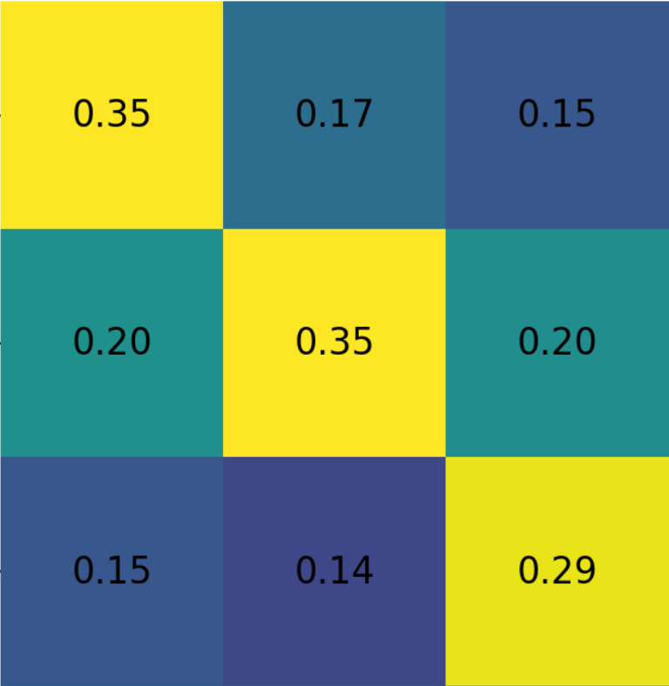
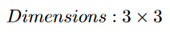
CLIP (Contrastive Language-Image Pre-Training)
a black-and-white silhouette of a horse
a page of text about segmentation
a cup of coffee on a saucer
Text Encoder
×
Image Encoder
[1] Radford, Alec, et al. "Learning transferable visual models from natural language supervision." International conference on machine learning. PMLR, 2021.

Slide 14
CLIP (Contrastive Language-Image Pre-Training)
Text Encoder
This is the part of CLIP that is used in text-to-image models
[1] Radford, Alec, et al. "Learning transferable visual models from natural language supervision." International conference on machine learning. PMLR, 2021.

Slide 15

Diffusion
Diffusion generates realistic images from random noise
It works by training a denoising neural network
When generating the image, we start from pure noise then repeatedly denoise and renoise our image
Diffusion is very slow and very expensive
[2] Ho, Jonathan, Ajay Jain, and Pieter Abbeel. "Denoising diffusion probabilistic models." Advances in neural information processing systems 33 (2020): 6840-6851.

Slide 16
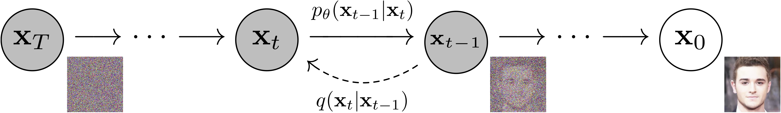
Diffusion
We can model diffusion as a Markov chain, when every step of the diffusion process is dependent only on the previous step
[2] Ho, Jonathan, Ajay Jain, and Pieter Abbeel. "Denoising diffusion probabilistic models." Advances in neural information processing systems 33 (2020): 6840-6851.

Slide 17
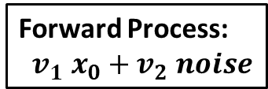
Diffusion
We can model diffusion as a Markov chain, when every step of the diffusion process is dependent only on the previous step
Forward Process:
${v_{1} x}_{0}+v_{2} noise$
[2] Ho, Jonathan, Ajay Jain, and Pieter Abbeel. "Denoising diffusion probabilistic models." Advances in neural information processing systems 33 (2020): 6840-6851.

Slide 18
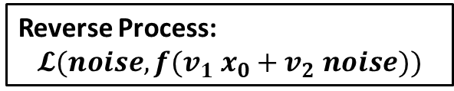
Diffusion
We can model diffusion as a Markov chain, when every step of the diffusion process is dependent only on the previous step
Reverse Process:
$$𝓛(noise,{{f(v}_{1} x}_{0}+v_{2} noise))$$
[2] Ho, Jonathan, Ajay Jain, and Pieter Abbeel. "Denoising diffusion probabilistic models." Advances in neural information processing systems 33 (2020): 6840-6851.

Slide 19
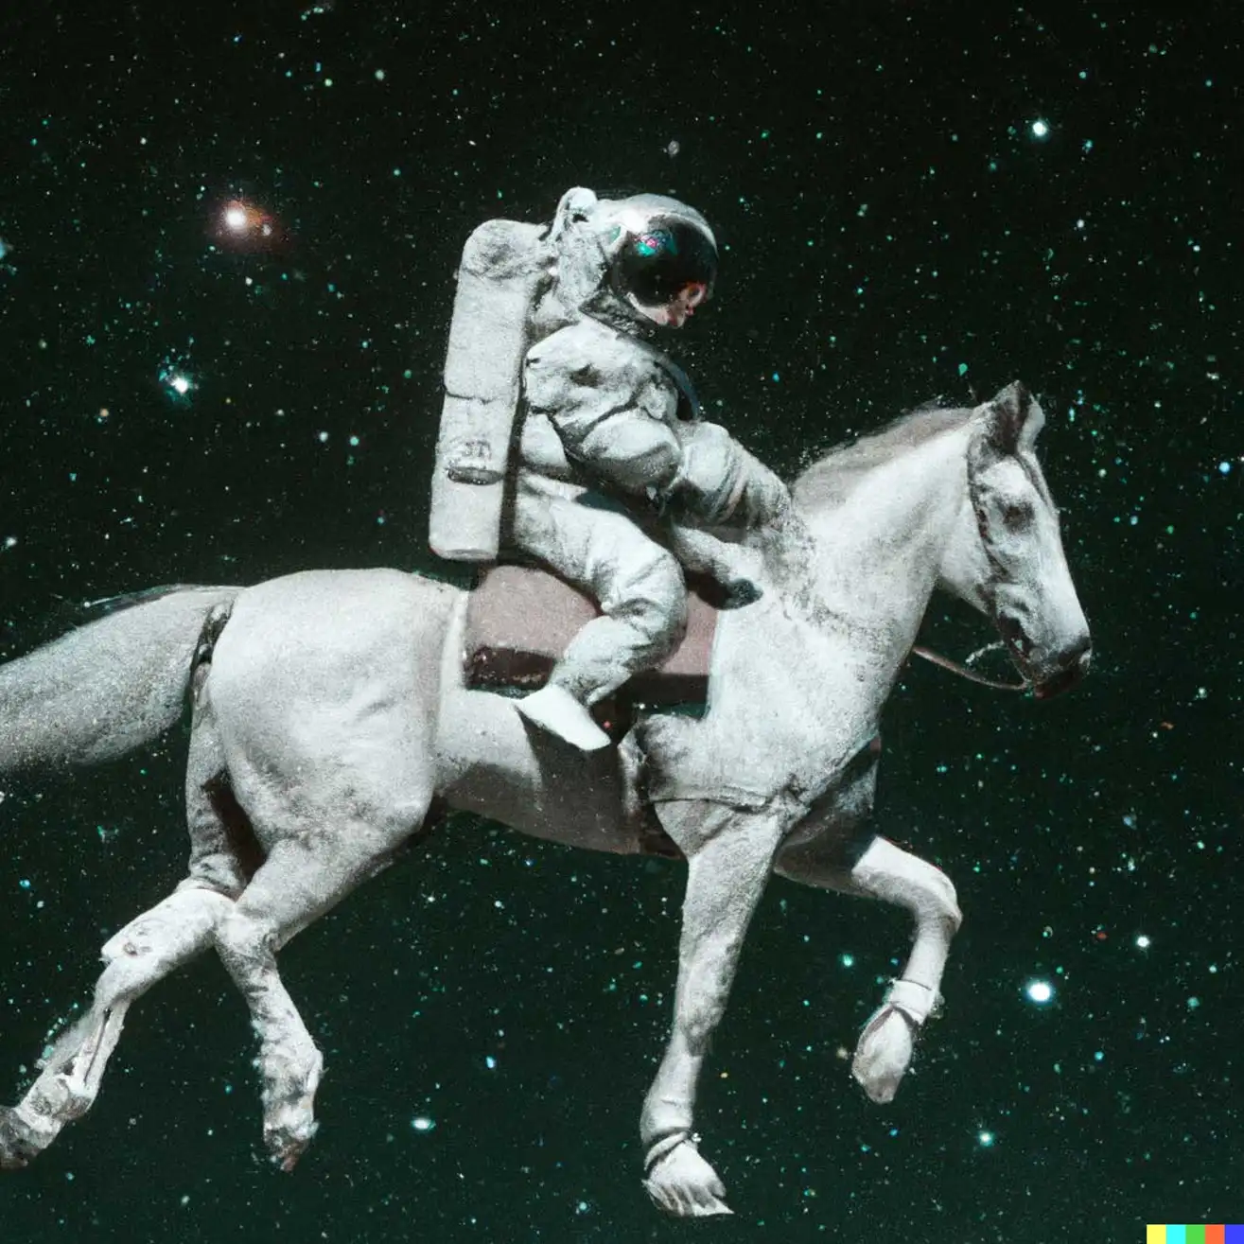
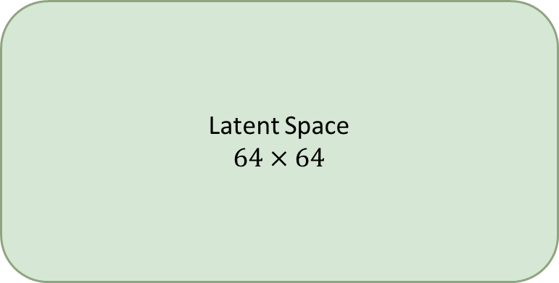
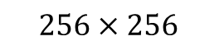
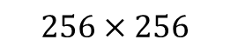
Stable Diffusion Model
Step 1: Train an autoencoder to shrink the image to a smaller latent space representation
Step 2: Train the diffusion model in the latent space for lower computational cost
Latent Space
$$64×64$$
Image Encoder
Image Decoder
$$256×256$$
$$256×256$$
[3] Rombach, Robin, et al. "High-resolution image synthesis with latent diffusion models." Proceedings of the IEEE/CVF conference on computer vision and pattern recognition. 2022.

Slide 20
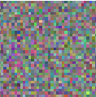
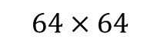
Stable Diffusion Model
“A photo of an astronaut riding a horse.”
Text Encoder
Diffusion Process in Latent Space
xT
xt
x1
Image Decoder
$$64×64$$
$$256×256$$
[3] Rombach, Robin, et al. "High-resolution image synthesis with latent diffusion models." Proceedings of the IEEE/CVF conference on computer vision and pattern recognition. 2022.

Slide 21
How Can We Use Text-to-Image Models?

Slide 22
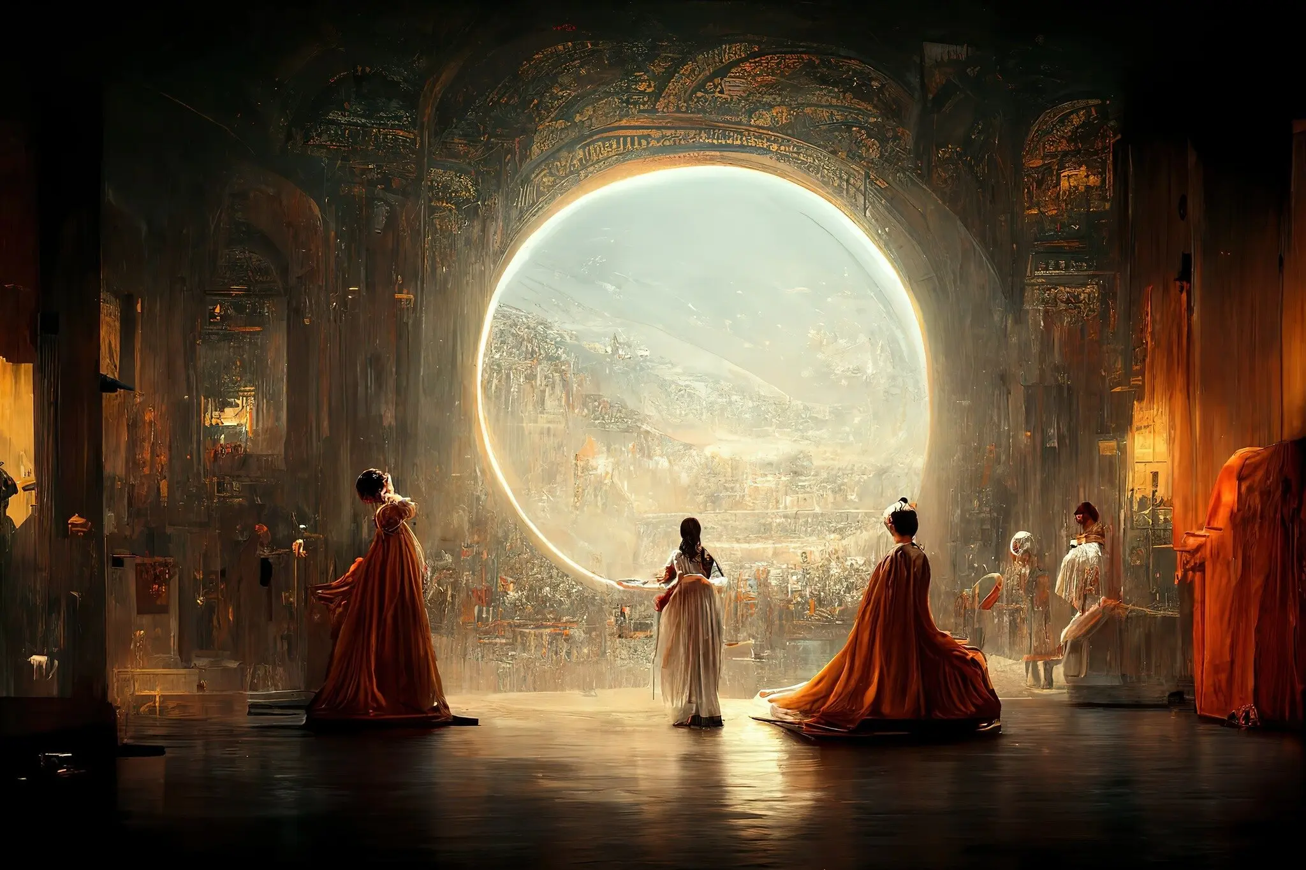
Real World Applications
AI generated art (this picture caused controversy after winner the Colorado state fair’s emerging digital artists award in 2022)
Drafting art works
Story boarding
Image editing

Slide 23
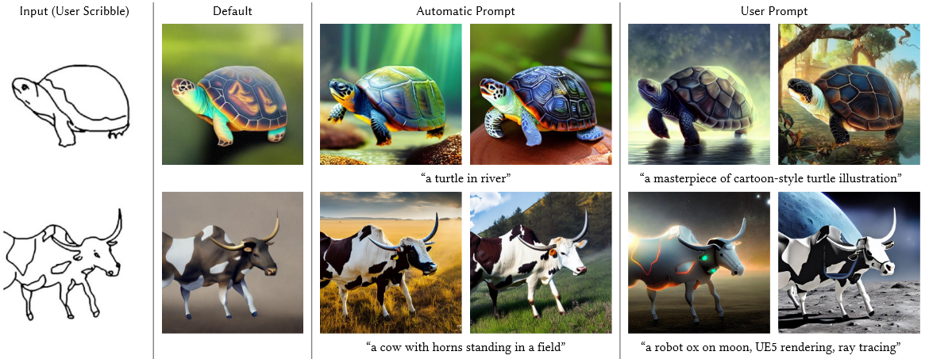
ControlNet
Allows stable diffusion to be finetuned so it can take in extra conditions
[4] Zhang, Lvmin, and Maneesh Agrawala. "Adding conditional control to text-to-image diffusion models." arXiv preprint arXiv:2302.05543 (2023).

Slide 24
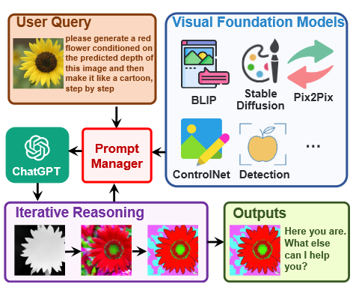
Visual ChatGPT
[9] Wu, Chenfei, et al. "Visual chatgpt: Talking, drawing and editing with visual foundation models." arXiv preprint arXiv:2303.04671 (2023).

Slide 25
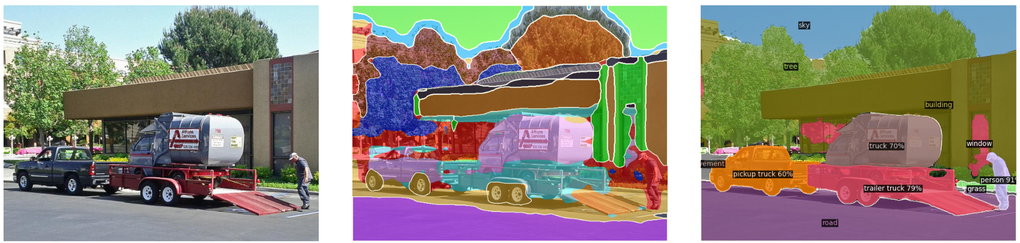
ODISE
Segmentation can be done using internal features from stable diffusion
Open-vocabulary, meaning there is no predefined list of categories
Input Image
ODISE Segmentation
[5] Xu, Jiarui, et al. "Open-vocabulary panoptic segmentation with text-to-image diffusion models." Proceedings of the IEEE/CVF Conference on Computer Vision and Pattern Recognition. 2023.

Slide 26
DreamBooth
Enables a text-to-image model to represent a specific subject
Start with a pretrained stable diffusion model, then finetune on 3 – 5 images of a specific animal, landmark, person, landscape etc.
To prevent stable diffusion from forgetting old concept we also use prior preserving loss
[6] Ruiz, Nataniel, et al. "Dreambooth: Fine tuning text-to-image diffusion models for subject-driven generation." Proceedings of the IEEE/CVF Conference on Computer Vision and Pattern Recognition. 2023.

Slide 27
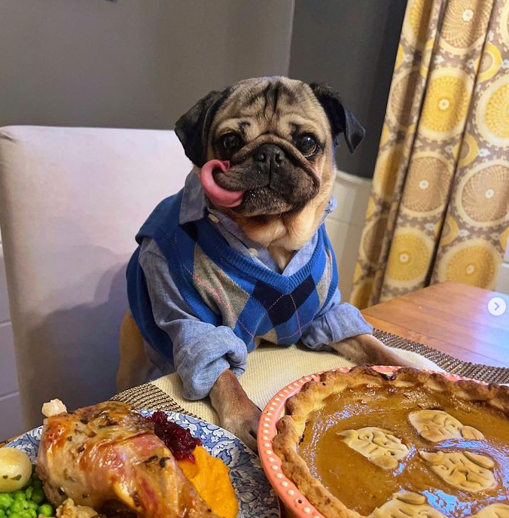
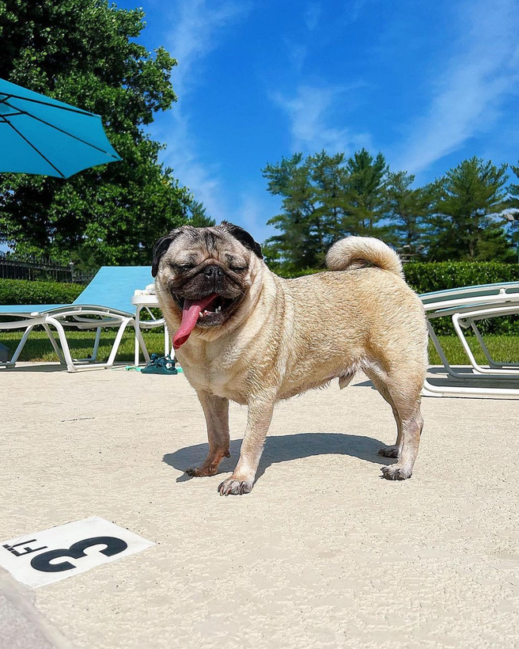
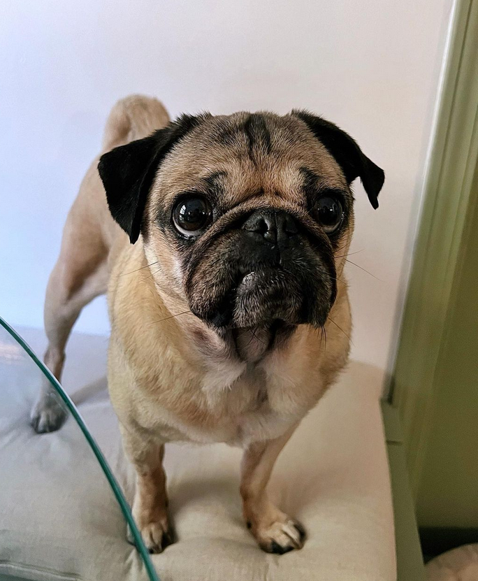
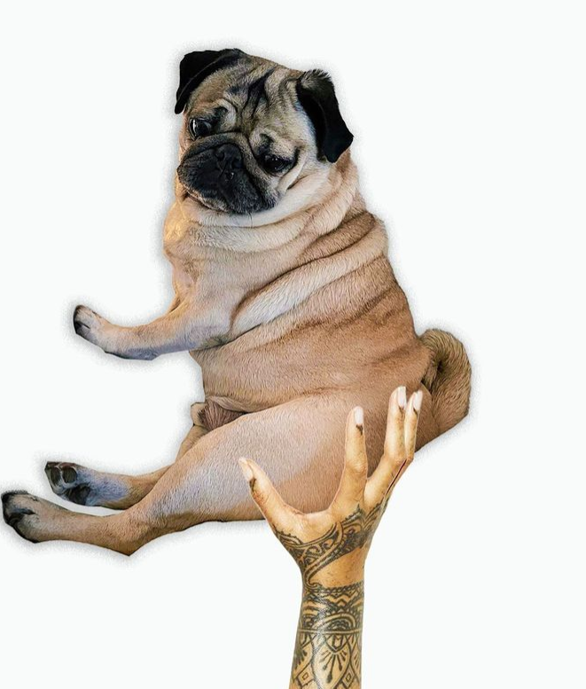
DreamBooth
Finetuning dataset
[6] Ruiz, Nataniel, et al. "Dreambooth: Fine tuning text-to-image diffusion models for subject-driven generation." Proceedings of the IEEE/CVF Conference on Computer Vision and Pattern Recognition. 2023.

Slide 28
DreamBooth
Finetuning dataset
Finetuning prompt
photo of zwx dog
[6] Ruiz, Nataniel, et al. "Dreambooth: Fine tuning text-to-image diffusion models for subject-driven generation." Proceedings of the IEEE/CVF Conference on Computer Vision and Pattern Recognition. 2023.

Slide 29
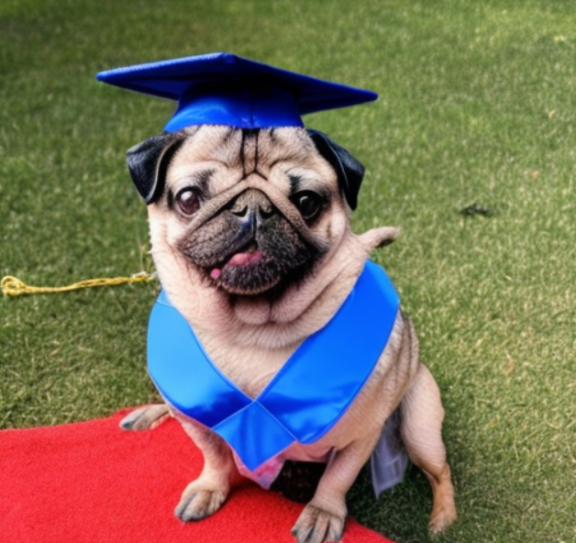
DreamBooth
Finetuning dataset
Finetuning prompt
Inference
photo of zwx dog
photo of zwx dog graduating with honours
[6] Ruiz, Nataniel, et al. "Dreambooth: Fine tuning text-to-image diffusion models for subject-driven generation." Proceedings of the IEEE/CVF Conference on Computer Vision and Pattern Recognition. 2023.

Slide 30
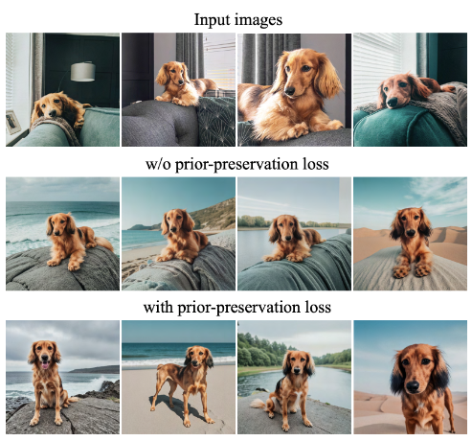
DreamBooth
Prior preserving loss prevent stable diffusion from forgetting old concepts and prevent over fitting
It is simply implemented by finetuning on outputs from the pretrained stable diffusion
This prevents the model from drifting too far from its initial state
[6] Ruiz, Nataniel, et al. "Dreambooth: Fine tuning text-to-image diffusion models for subject-driven generation." Proceedings of the IEEE/CVF Conference on Computer Vision and Pattern Recognition. 2023.

Slide 31
What Are The Ethical Considerations?

Slide 32
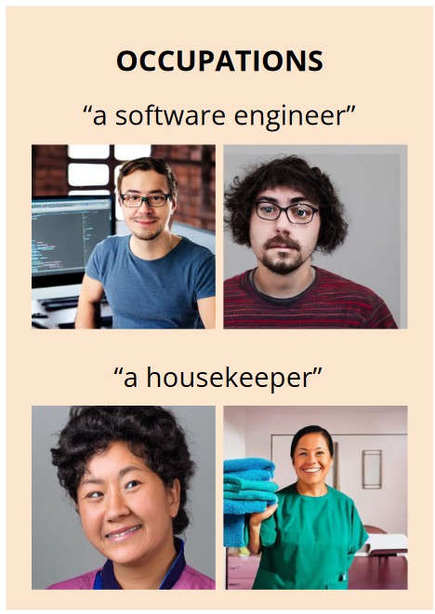
Algorithmic Bias
Software engineers are ≈90% male, however one study found stable diffusion depicted software engineers as male 100% of the time.
This suggests that stereotypes are being amplified by text-to-image models
Better curation of training data is needed
Transforming a user's input prompt may also be helpful
[7] Bianchi, Federico, et al. "Easily accessible text-to-image generation amplifies demographic stereotypes at large scale." Proceedings of the 2023 ACM Conference on Fairness, Accountability, and Transparency. 2023.

Slide 33
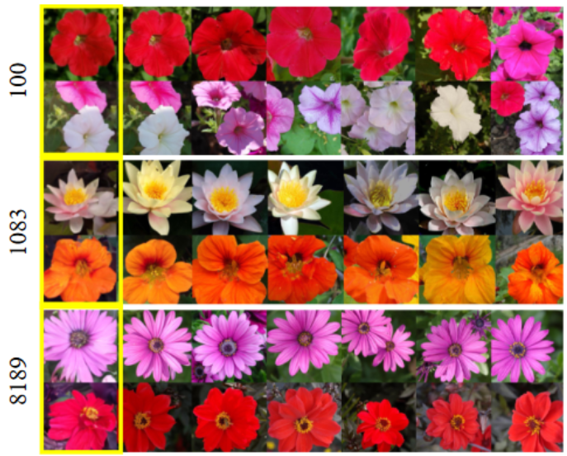
Digital Art or Digital Forgery?
For small datasets, diffusion models can just copy the training data
Overfitting and repeated data in the training set can also cause content replication
Even if image are not directly copied, copyrighted data exist within training data
[8] Somepalli, Gowthami, et al. "Diffusion art or digital forgery? investigating data replication in diffusion models." Proceedings of the IEEE/CVF Conference on Computer Vision and Pattern Recognition. 2023.

Slide 34
References
[1] Radford, Alec, et al. "Learning transferable visual models from natural language supervision." International conference on machine learning. PMLR, 2021.
[2] Ho, Jonathan, Ajay Jain, and Pieter Abbeel. "Denoising diffusion probabilistic models." Advances in neural information processing systems 33 (2020): 6840-6851.
[3] Rombach, Robin, et al. "High-resolution image synthesis with latent diffusion models." Proceedings of the IEEE/CVF conference on computer vision and pattern recognition. 2022.
[4] Zhang, Lvmin, and Maneesh Agrawala. "Adding conditional control to text-to-image diffusion models." arXiv preprint arXiv:2302.05543 (2023).
[5] Xu, Jiarui, et al. "Open-vocabulary panoptic segmentation with text-to-image diffusion models." Proceedings of the IEEE/CVF Conference on Computer Vision and Pattern Recognition. 2023.
[6] Ruiz, Nataniel, et al. "Dreambooth: Fine tuning text-to-image diffusion models for subject-driven generation." Proceedings of the IEEE/CVF Conference on Computer Vision and Pattern Recognition. 2023.
[7] Bianchi, Federico, et al. "Easily accessible text-to-image generation amplifies demographic stereotypes at large scale." Proceedings of the 2023 ACM Conference on Fairness, Accountability, and Transparency. 2023.
[8] Somepalli, Gowthami, et al. "Diffusion art or digital forgery? investigating data replication in diffusion models." Proceedings of the IEEE/CVF Conference on Computer Vision and Pattern Recognition. 2023.
[9] Wu, Chenfei, et al. "Visual chatgpt: Talking, drawing and editing with visual foundation models." arXiv preprint arXiv:2303.04671 (2023).

